Slide 1
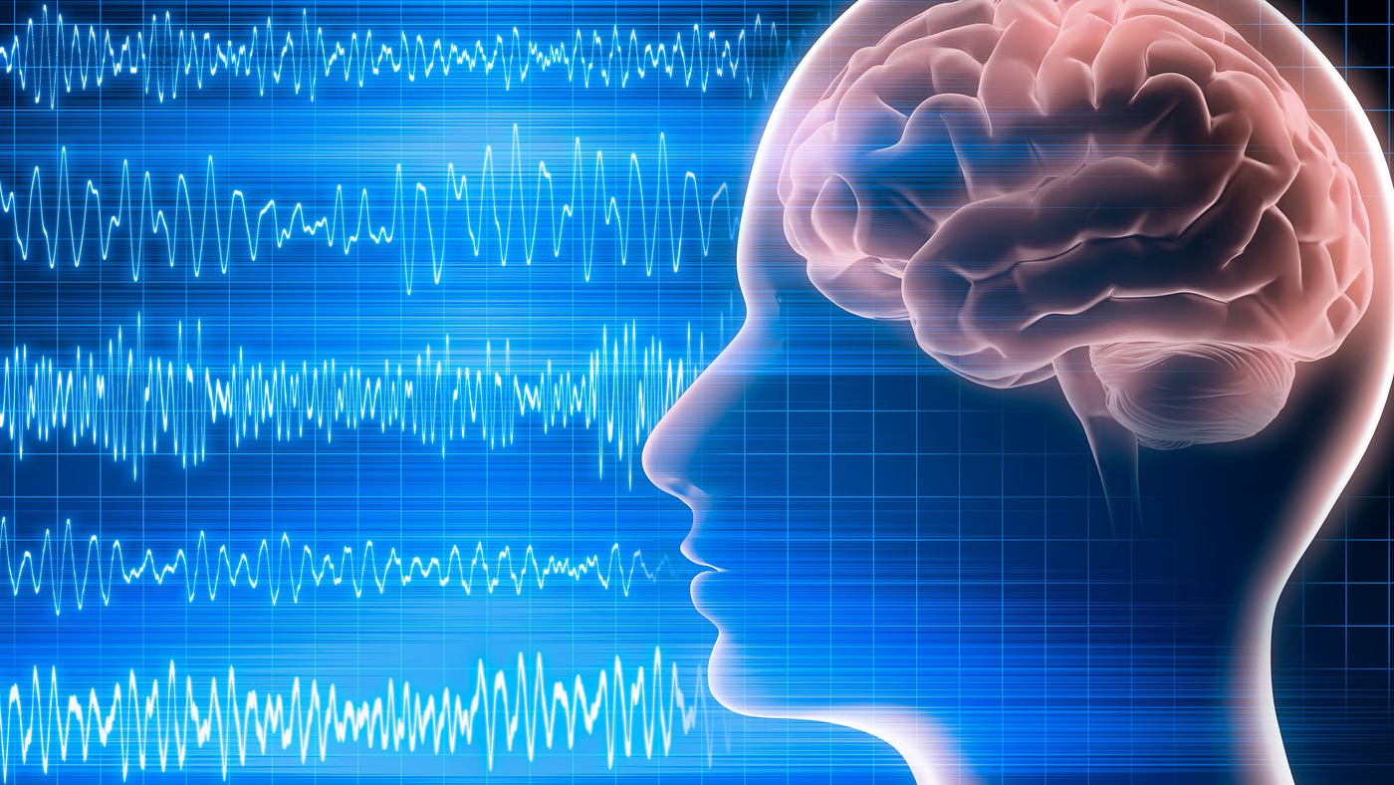
EEG-BASED CYBERSICKNESS DETECTION USING A HYBRID CNN-TRANSFORMER APPROACH

Slide 2
INTRODUCTION
Background
Cybersickness is a common and debilitating issue in Virtual Reality (VR) environments, characterized by symptoms such as nausea, dizziness, and disorientation. These symptoms can significantly hinder the user experience, limiting the potential of VR applications.
The Challenge
Reliance on Subjective Assessments: Self-reported questionnaires, which are inconsistent, delayed, and unsuitable
Limited Use of EEG in Real-Time Detection: Prior models lack temporal modeling and are not optimized for live classification.

Slide 3
INTRODUCTION
Significance
Enables real-time, objective detection of cybersickness using EEG signals.
Utilizes a hybrid CNN-Transformer model for accurate brain signal analysis.
Enhances VR safety and user experience across various real-world applications.
The Opportunity
Electroencephalography (EEG) signals, which capture brain activity, offer a promising avenue for detecting physiological states like cybersickness. Advances in deep learning provide the tools to analyze complex EEG data, enabling the development of more robust and reliable detection frameworks.

Slide 4
PROBLEM STATEMENT
Cybersickness is a major barrier to the widespread adoption of VR, causing symptoms like nausea, dizziness, and disorientation.
Existing detection methods are subjective, relying on post-experience questionnaires which are inconsistent and not real-time.
There's a lack of objective, automated, and real-time systems for early detection and prevention of cybersickness.
While EEG offers potential, many existing approaches either ignore temporal patterns or use shallow models, leading to lower accuracy.
There is a need for a deep learning-based solution that can effectively process EEG data and predict cybersickness in a reliable and timely manner.

Slide 5
Research objectives
Primary Objective:
Develop a novel approach involving a hybrid-transformer architecture utilizing EEG signals for the real-time detection of cybersickness in VR environments.
Specific Objectives:
Objective 1: Collect and preprocess a comprehensive dataset of EEG signals during VR exposure to capture diverse user experiences.
Objective 2: Design and implement a hybrid-transformer architecture tailored for analyzing EEG data related to cybersickness.
Objective 3: Evaluate the model's accuracy and reliability in predicting cybersickness across different VR applications and user profiles.

Slide 6
Proposed system - introduction
System Overview
Raw EEG Signals: Non-invasive method for detection but require preprocessing.
Preprocessing Pipeline
Filtering:
Bandpass (4-40 Hz): Removes drift and noise.
Notch (50 Hz): Suppresses powerline interference.
Artifact Removal by Independent Component Analysis (ICA): Eliminates eye/muscle noise.
Segmentation & Feature Extraction:
Splits EEG into segments of 60s & extract statistical & frequency-based features using FFT.
Deep Learning Model
CNN: Captures spatial EEG patterns.
Transformer: Learns temporal dependencies.
Fusion Layer: Combines CNN & Transformer outputs.
Fully Connected Layer + Softmax: Classifies cybersickness.
Outcome
High accuracy in cybersickness detection.
Enhances VR experience by enabling real-time monitoring.

Slide 7
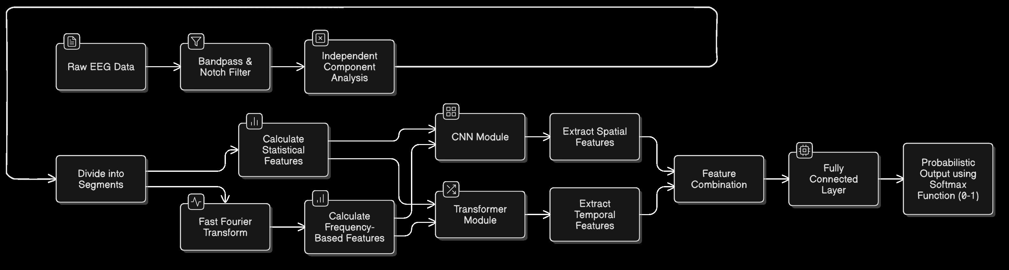
Proposed system - diagram

Slide 8
Proposed system – list of modules
List of Modules:
Preprocessing Module
CNN Module
Transformer Module
Fusion Layer
Classification Layer

Slide 9
Proposed system – PREPROCESSING MODULE
Objective: Prepare EEG data for effective feature extraction and model training.
Approach:
Artifact Removal: Use Bandpass, notch filter and ICA to remove artifacts and isolate relevant EEG signals.
Normalization: Apply z-score normalization to standardize EEG signals.
Fast-Fourier Transform: Convert data to frequency domain to determine the optimal value of ‘k’ for segmentation. This will also be used to extract frequency-based features.
Segmentation: Use sliding windows and loops to segment the EEG data.
Feature Extraction: Extract time-domain and frequency-domain features.
Advantages:
Reduces noise and enhances signal quality.
Simplifies data and improves model performance.

Slide 10
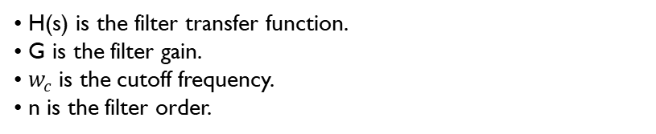
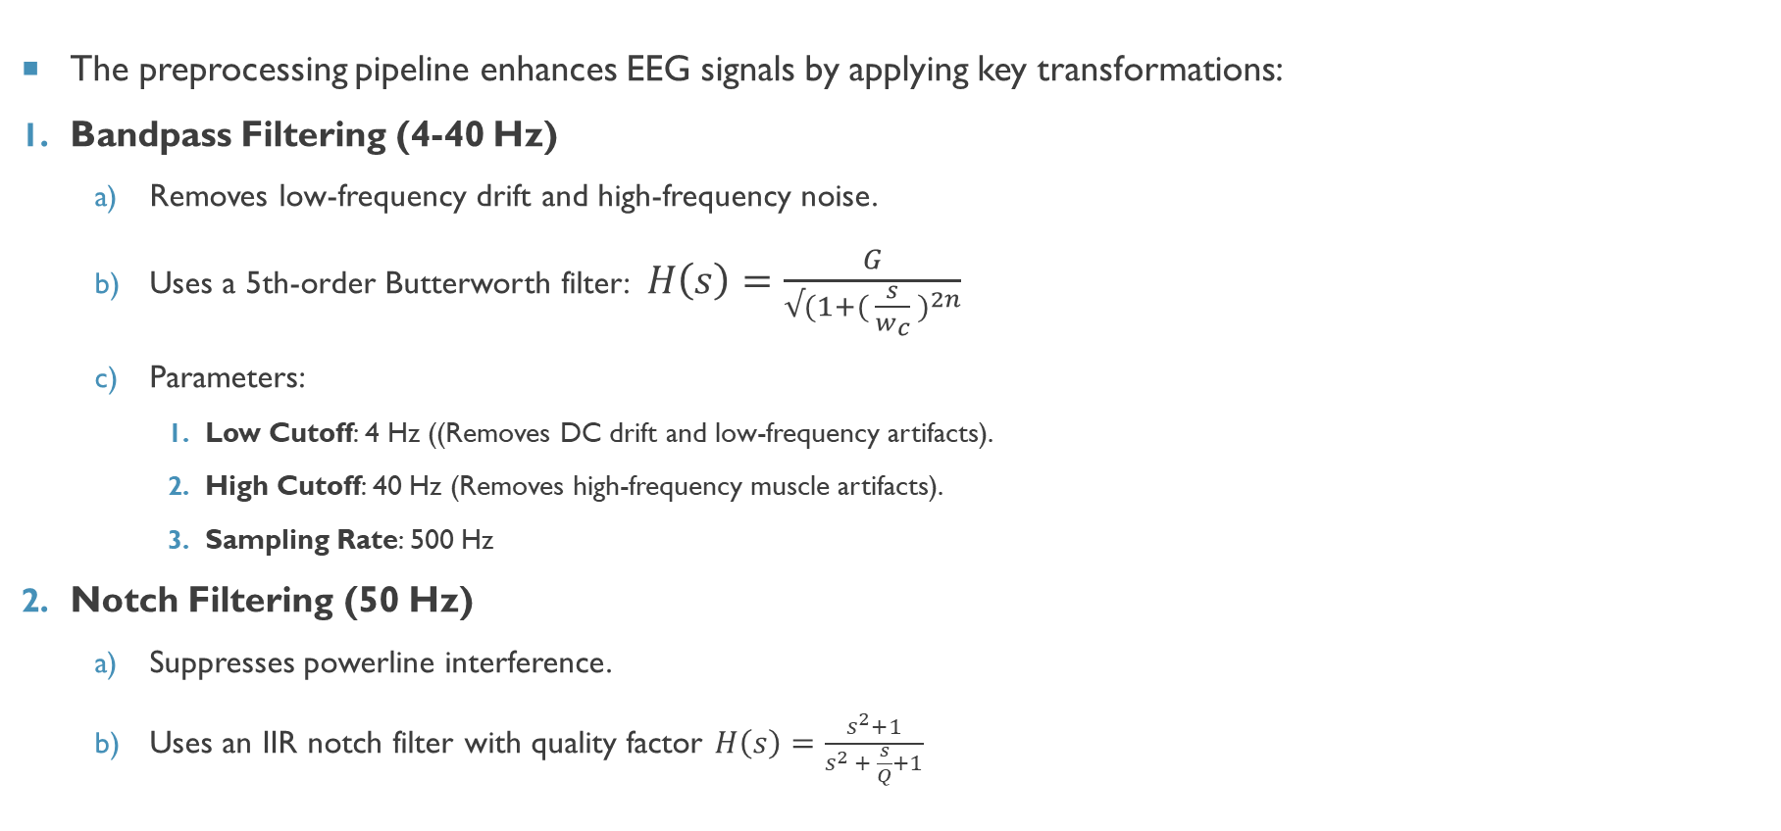
Proposed system – PREPROCESSING MODULE
The preprocessing pipeline enhances EEG signals by applying key transformations:
Bandpass Filtering (4-40 Hz)
Removes low-frequency drift and high-frequency noise.
Uses a 5th-order Butterworth filter: $H\left(s\right)=\frac{G}{√(1+{( \frac{s}{w_{c}} )}^{2n}}$
Parameters:
Low Cutoff: 4 Hz ((Removes DC drift and low-frequency artifacts).
High Cutoff: 40 Hz (Removes high-frequency muscle artifacts).
Sampling Rate: 500 Hz
Notch Filtering (50 Hz)
Suppresses powerline interference.
Uses an IIR notch filter with quality factor $H\left(s\right)=\frac{s^{2}+1}{s^{2 }+ \frac{s}{Q}+1}$
H(s) is the filter transfer function.
G is the filter gain.
$w_{c}$is the cutoff frequency.
n is the filter order.
Q is the quality factor, controlling bandwidth. Q=30
Default Notch Frequency: 50 Hz.

Slide 11
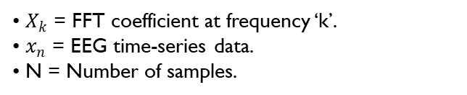
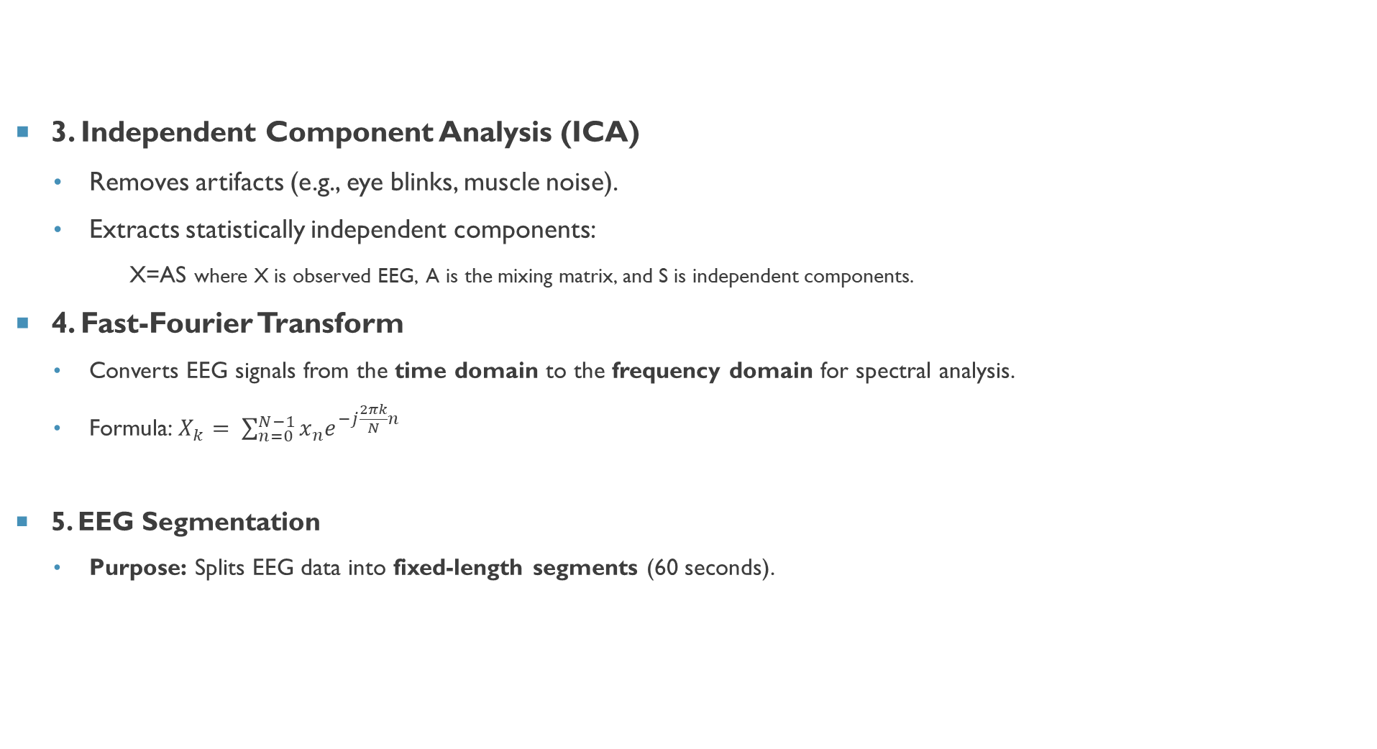
Proposed system – PREPROCESSING MODULE
3. Independent Component Analysis (ICA)
Removes artifacts (e.g., eye blinks, muscle noise).
Extracts statistically independent components:
X=AS where X is observed EEG, A is the mixing matrix, and S is independent components.
4. Fast-Fourier Transform
Converts EEG signals from the time domain to the frequency domain for spectral analysis.
Formula: $X_{k}= \sum_{n=0}^{N−1}{x_{n}e^{−j\frac{2πk}{N}n}}$
5. EEG Segmentation
Purpose: Splits EEG data into fixed-length segments (60 seconds).
$X_{k}$ = FFT coefficient at frequency ‘k’.
$x_{n}$​ = EEG time-series data.
N = Number of samples.

Slide 12
Proposed system – PREPROCESSING MODULE
6. Feature Extraction
Statistical Features: Mean, Variance, Skewness, Kurtosis, RMS, Peak-to-Peak.
Spectral Features (via Welch’s method): Delta (0.5-4 Hz), Theta (4-8 Hz), Alpha (8-13 Hz), Beta (13-30 Hz), Gamma (30-100 Hz).
Entropy & Peak Frequency: Measures signal complexity and dominant frequency.
7. Batch Processing
Reads EEG files (.easy format) from categories ("Cybersick," "Normal").
Applies preprocessing and saves extracted features into CSV.

Slide 13

Proposed System – Preprocessing Module
8. Post-Feature Extraction Processing
Low Variance Feature Removal
Features with very low variance across all samples provide little to no discriminative power
These were removed using a threshold (variance < 0.01)
Correlation Filtering
A correlation matrix was computed to identify pairs of features with high correlation (r > 0.9)
Among highly correlated pairs, one feature was dropped to reduce redundancy
Resulting Dimensionality
Original: 2*(20*20-30 lakhs, 13)
After Filtering: (3209, 50)

Slide 14
Proposed system – CNN MODULE
Objective:
Extract spatial features from EEG signals using Convolutional Neural Networks (CNNs).
Architecture:
Conv1: Convolutional layer with 32 filters, kernel size (3, 3), stride (1, 1), padding 'same'.
ReLU1: ReLU activation.
Pool1: Max-pooling layer with pool size (2, 2).
Conv2: Convolutional layer with 64 filters, kernel size (3, 3), stride (1, 1), padding 'same'.
ReLU2: ReLU activation.
Pool2: Max-pooling layer with pool size (2, 2).
Flatten: Flatten the 3D tensor into a flat 1D vector for downstream fusion

Slide 15
Proposed system – Transformer Module
Objective:
Capture long-range temporal dependencies in the extracted features using Transformers.
Architecture:
Conv1D Layer: 64 filters, kernel size 1, ReLU activation — used to increase feature dimensionality before the Transformer
Transformer Block:
Multi-Head Attention: 4 heads, key dimension 64
Feedforward Network: Hidden layer with 128 units
Residual Connections and Layer Normalization for stable training
Dropout: Regularization with a rate of 0.1
GlobalAveragePooling1D: Aggregates the encoded sequence into a fixed-length vector
Output: [Batch Size, Sequence Length, Hidden Size]

Slide 16
Proposed system – Fusion layer
Objective:
Combine the outputs of the CNN and Transformer modules to leverage both spatial and temporal features.
Approach:
Concatenation: Concatenate the flattened output of the CNN module and the output of the Transformer module.
Dense Layer 1: Fully connected layer with 128 units and ReLU activation.
Dropout : Apply dropout with a rate of 0.2 to prevent overfitting.
Dense Layer 2 : Fully connected layer with 64 units and ReLU activation.
Output Layer : Fully connected layer with sigmoid activation for classification.
Advantages:
Integrates spatial and temporal features for comprehensive analysis.
Enhances model performance and robustness.

Slide 17
Proposed system – Classification layer
Objective: Classify EEG signals in real-time to detect cybersickness.
Approach:
Real-Time Processing: Use sliding windows to process EEG data in real-time.
Evaluation Metrics: Accuracy, precision, recall, and F1-score for classification performance.
Attention Visualization: Visualize attention weights to interpret model behavior.

Slide 18
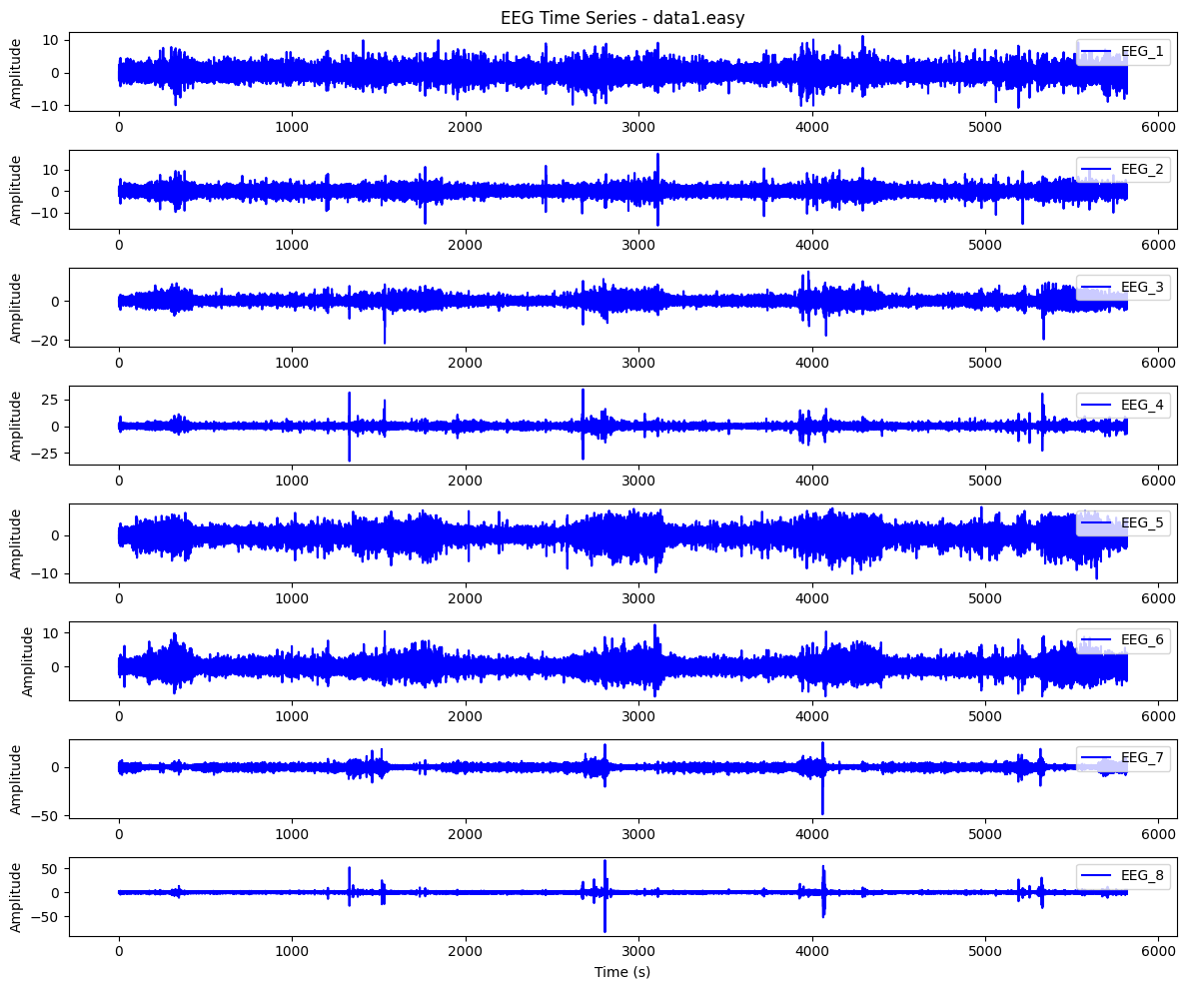
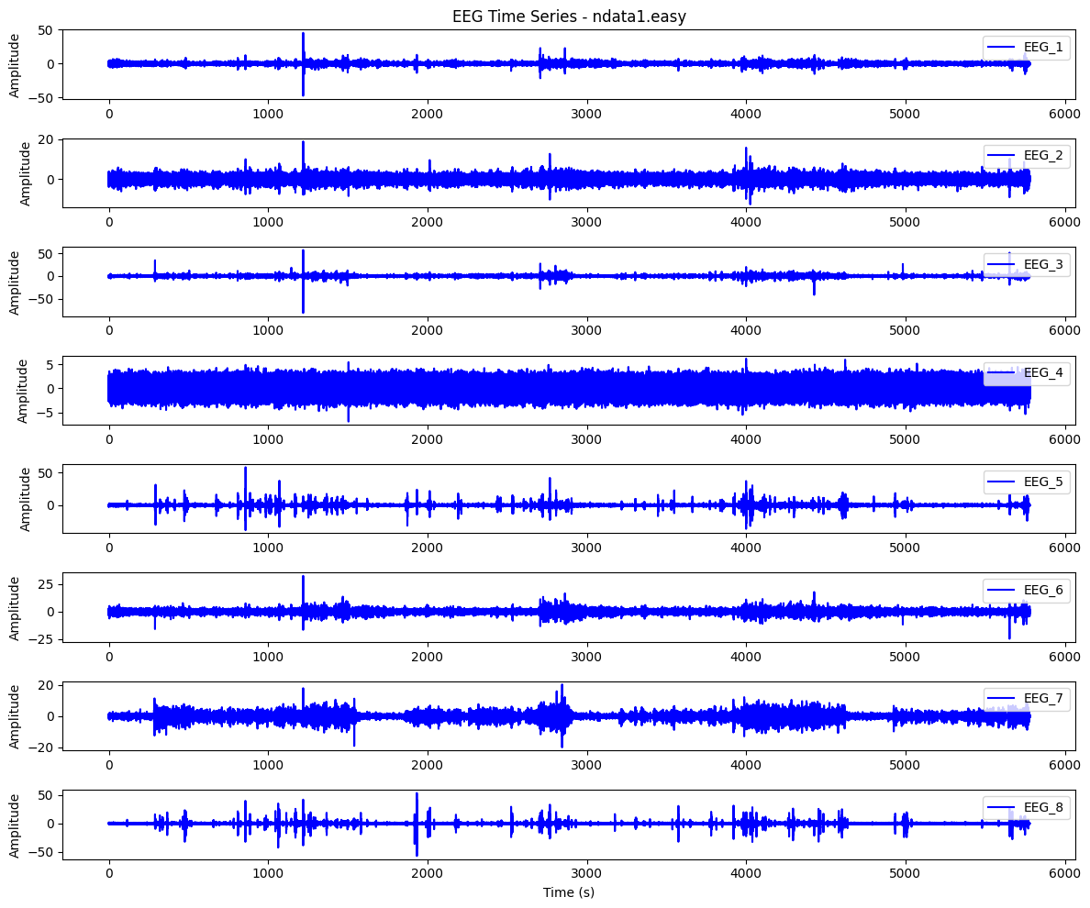
IMPLEMENTATION – time series plot

Slide 19
IMPLEMENTATION – time series PLOT INFERENCE
Key Differences in EEG Signals:
Variability: Cybersick EEG has higher fluctuations, while normal EEG is more stable.
Spikes & Artifacts: More frequent and larger spikes in cybersick EEG.
Noise & Amplitude: Cybersick EEG shows higher baseline noise and amplitude.
Drift: Cybersick EEG has noticeable low-frequency drifts; normal EEG remains consistent.

Slide 20
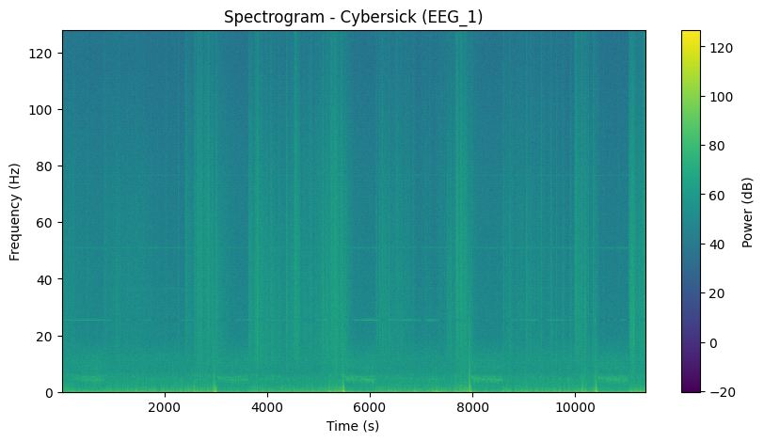
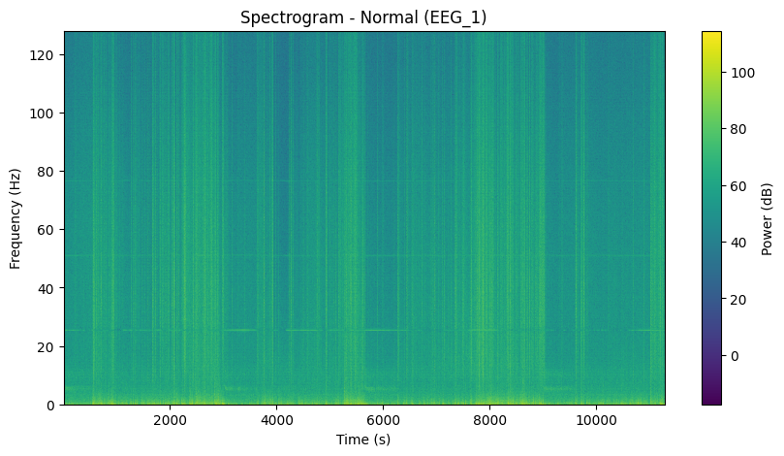
IMPLEMENTATION – SPECTOGRAM VISUALITION
1) Power Distribution
Both spectrograms show power concentrated in lower frequencies (~0-30 Hz), typical for EEG signals.
The cyber-sick condition exhibits slightly lower power in the low-frequency range, which might indicate altered neural activity.
2) Temporal Variations
The normal spectrogram appears more consistent over time, with uniform greenish streaks.
The cyber-sick spectrogram has more dispersed power fluctuations, possibly due to cybersickness-related brain state changes.
3) High-Frequency Activity
Cyber-sick shows scattered power variations in higher frequencies (>40 Hz).

Slide 21
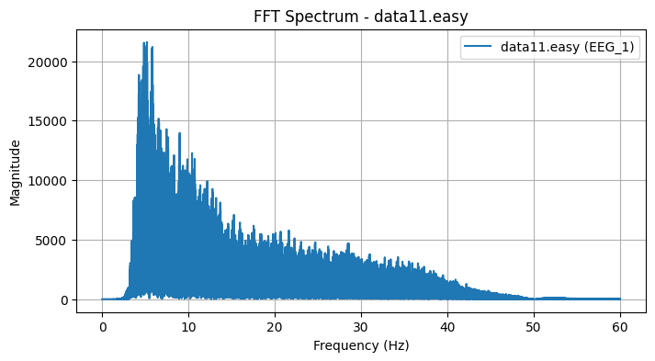
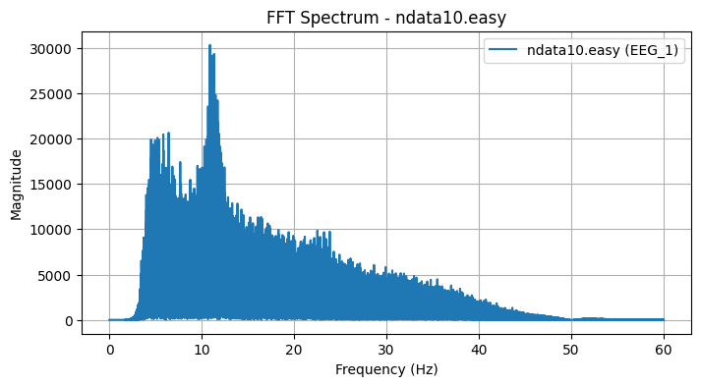
IMPLEMENTATION – FFT visualization
The FFT plots reveal dominant frequency components in EEG signals across different states.
Normal EEG segments show well-distributed power in alpha and beta bands, with smoother spectral transitions.
Cybersick EEG segments exhibit irregular frequency peaks and elevated power in low-frequency bands (delta, theta), suggesting disrupted neural activity.
These spectral differences support the model’s ability to distinguish between normal and cybersick conditions.

Slide 22
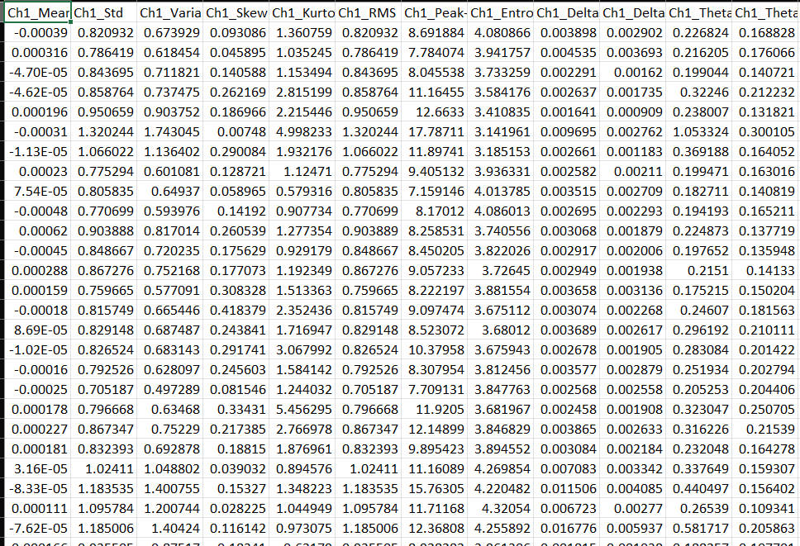
Implementation – Feature Extraction
CSV File Overview:
File Contents: Each row corresponds to a 60-second EEG segment
Dimensionality:
Rows:
Cybersick Group: 1629 segments
Normal Group: 1580 segments
Columns:
154 features + 1 column indicating source file + 1 for segment number
Total columns: 156
Purpose:
Input to the model after feature selection
Captures both time-domain and frequency-domain properties of EEG signals

Slide 23
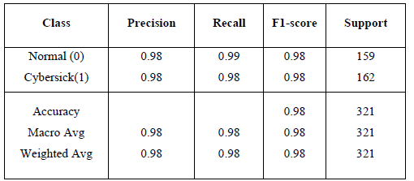
Results
The model demonstrated the following performance on the test set:
Test Accuracy: 98.44%
AUC-ROC: 0.9991 which signifies that the model has near-perfect class separation i.e. it almost always assigns higher probabilities to the correct class

Slide 24
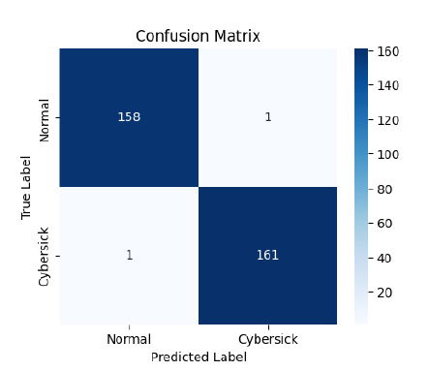
Results
The confusion matrix showed a balanced distribution of correct predictions across both classes, therefore verifying that the model is not biased towards any class.

Slide 25
Comparison with existing works
Reference | Model | EEG Channels/ Inputs | Accuracy (%) | Segment Length | Key Charecteristics
Yildirim et al. | RNN (LSTM, 3 time-steps, 7 dense) | 1-channel | 83.94 | 60 s | Time-series based with low accuracy
Liao et al. (2020) | LSTM + 7 dense | 10 nodes | 82.83 | 5 min | RMSProm, L1/L2 regularization
Li et al. (2020) | Polynomial SVM | Not specified | 79.25 | 4s | Wavelet-based energy ration
Proposed (ours) | CNN + Transformer | 154 extracted features | 98.44 | 60s | Fuses spatial + temporal features

Slide 26
Conclusion
A hybrid CNN + Transformer model was developed for real-time cybersickness detection using EEG signals
The system achieved 98.44% accuracy, significantly outperforming traditional models like Random Forest
The approach combines spatial (CNN) and temporal (Transformer) features for robust prediction
Preprocessing and feature engineering played a vital role in enhancing signal quality and model performance

Slide 27
Future Work
Dataset Expansion: Collect more diverse EEG data across different VR environments
Live Deployment: Integrate with wearable EEG devices and real VR headsets for real-time feedback
Model Enhancement: Explore advanced fusion techniques and multimodal input (e.g., heart rate, motion)

Slide 28
REFERENCES
Biswas, N., Mukherjee, A., & Bhattacharya, S. (2024). “Are you feeling sick?” A systematic literature review of cybersickness in virtual reality. ACM Computing Surveys.
Jeong, D., Yoo, S., & Yun, J. (2019, March). Cybersickness analysis with eeg using deep learning algorithms. In 2019 IEEE conference on virtual reality and 3D user interfaces (VR) (pp. 827-835). IEEE.
Yildirim, C. (2020, December). A review of deep learning approaches to EEG-based classification of cybersickness in virtual reality. In 2020 IEEE international conference on artificial intelligence and virtual reality (AIVR) (pp. 351-357). IEEE.
Li, G., McGill, M., Brewster, S., Chen, C. P., Anguera, J. A., Gazzaley, A., & Pollick, F. (2021). Multimodal biosensing for vestibular network-based cybersickness detection. IEEE Journal of Biomedical and Health Informatics, 26(6), 2469-2480.
Sun, J., Xie, J., & Zhou, H. (2021, March). EEG classification with transformer-based models. In 2021 ieee 3rd global conference on life sciences and technologies (lifetech) (pp. 92-93). IEEE.
Sun, J., Xie, J., & Zhou, H. (2021, March). EEG classification with transformer-based models. In 2021 ieee 3rd global conference on life sciences and technologies (lifetech) (pp. 92-93). IEEE.
Pahuja, S. K., & Veer, K. (2022). Recent approaches on classification and feature extraction of EEG signal: A review. Robotica, 40(1), 77-101
Chang, E., Billinghurst, M., & Yoo, B. (2023). Brain activity during cybersickness: A scoping review. Virtual reality, 27(3), 2073-2097

Slide 29

Thank You

